Slide 1
Literal Meaning to Insightful Observations
Making Strong Character Inferences

Slide 2
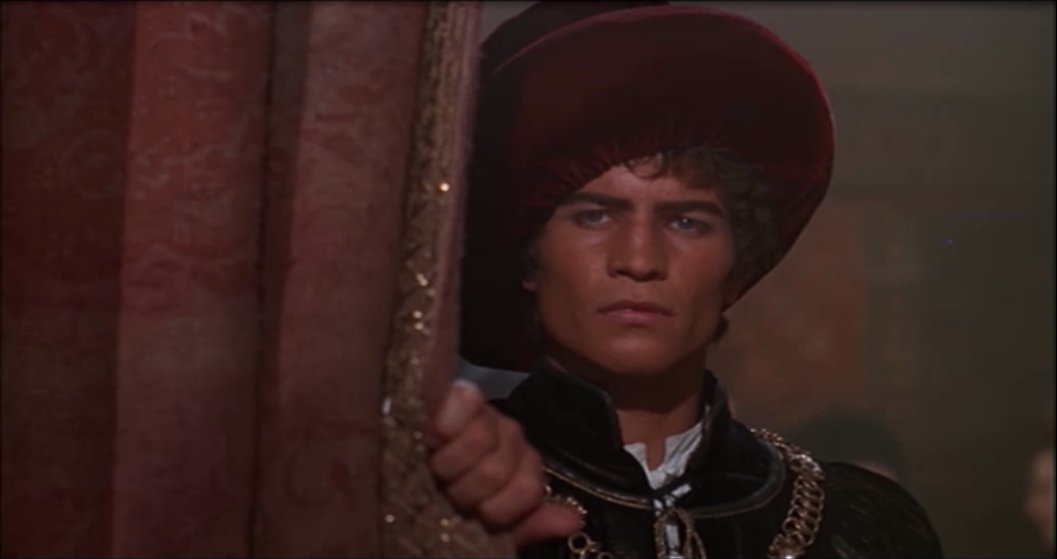
Literal Meaning vs. Deeper Meaning
When making an inference, you can infer the literal meaning of a quote or event. You can also make inferences that have deeper meaning beyond identifying synonyms of words.
“Uncle, this is a Montague, our foe, a villain, that is hither come in spite to scorn at our solemnity this night.”
Literal
Tybalt identifies Romeo and expresses his deep hate for Montagues.
Deeper
Readers can infer that Tybalt likes or at least wants to start trouble. Otherwise, he wouldn’t even bring it to Capulet’s attention.

Slide 3
More Examples
Literal
Deeper
“Go, girl, seek happy nights for happy days.”
-Nurse
Nurse telling Juliet to go get ready and seek out fun at the party.
Reader can infer that the nurse not only raised Juliet because it was her job, but she also truly cares for her happiness.
“Not having that which having makes them short.”
-Romeo
Romeo’s days seem long because he doesn’t have love, which is exciting and makes time go by quickly.
Readers can infer that Romeo is a relatively emotional character and is thinking about love. He emphasizes that his days seem long without love, which would make life more exciting and pass quicker.
The Nurse is telling a dirty joke/memory about Juliet and can’t stop laughing
She is talking about something that happened to Juliet in the past.
Readers can infer that the nurse can take a joke and doesn’t take things serious all the time. She is a laid back person who likes a good laugh.

Slide 4
More Examples
Literal
Deeper
Romeo jumps the wall to get to Juliet.
He is willing to risk sneaking into the Capulet grounds after the party.
Reader can infer that Romeo is a hopeless romantic because he is willing to take risks to see his love.
When she is alone (or thinks she is), Juliet speaks of Romeo.
She is talking about Romeo.
Readers can infer that Juliet has already fallen in love with Romeo. When she is alone, she thinks of him like a school-girl thinks of her crush.
“Is love a tender thing?”
-Romeo
Romeo is if love is supposed to actually be “tender.”
Readers can infer that Romeo has never experienced love before because he sees it as painful, so asks, should it be “tender?”

